Slide 1

Crafting compelling web presence

Slide 2
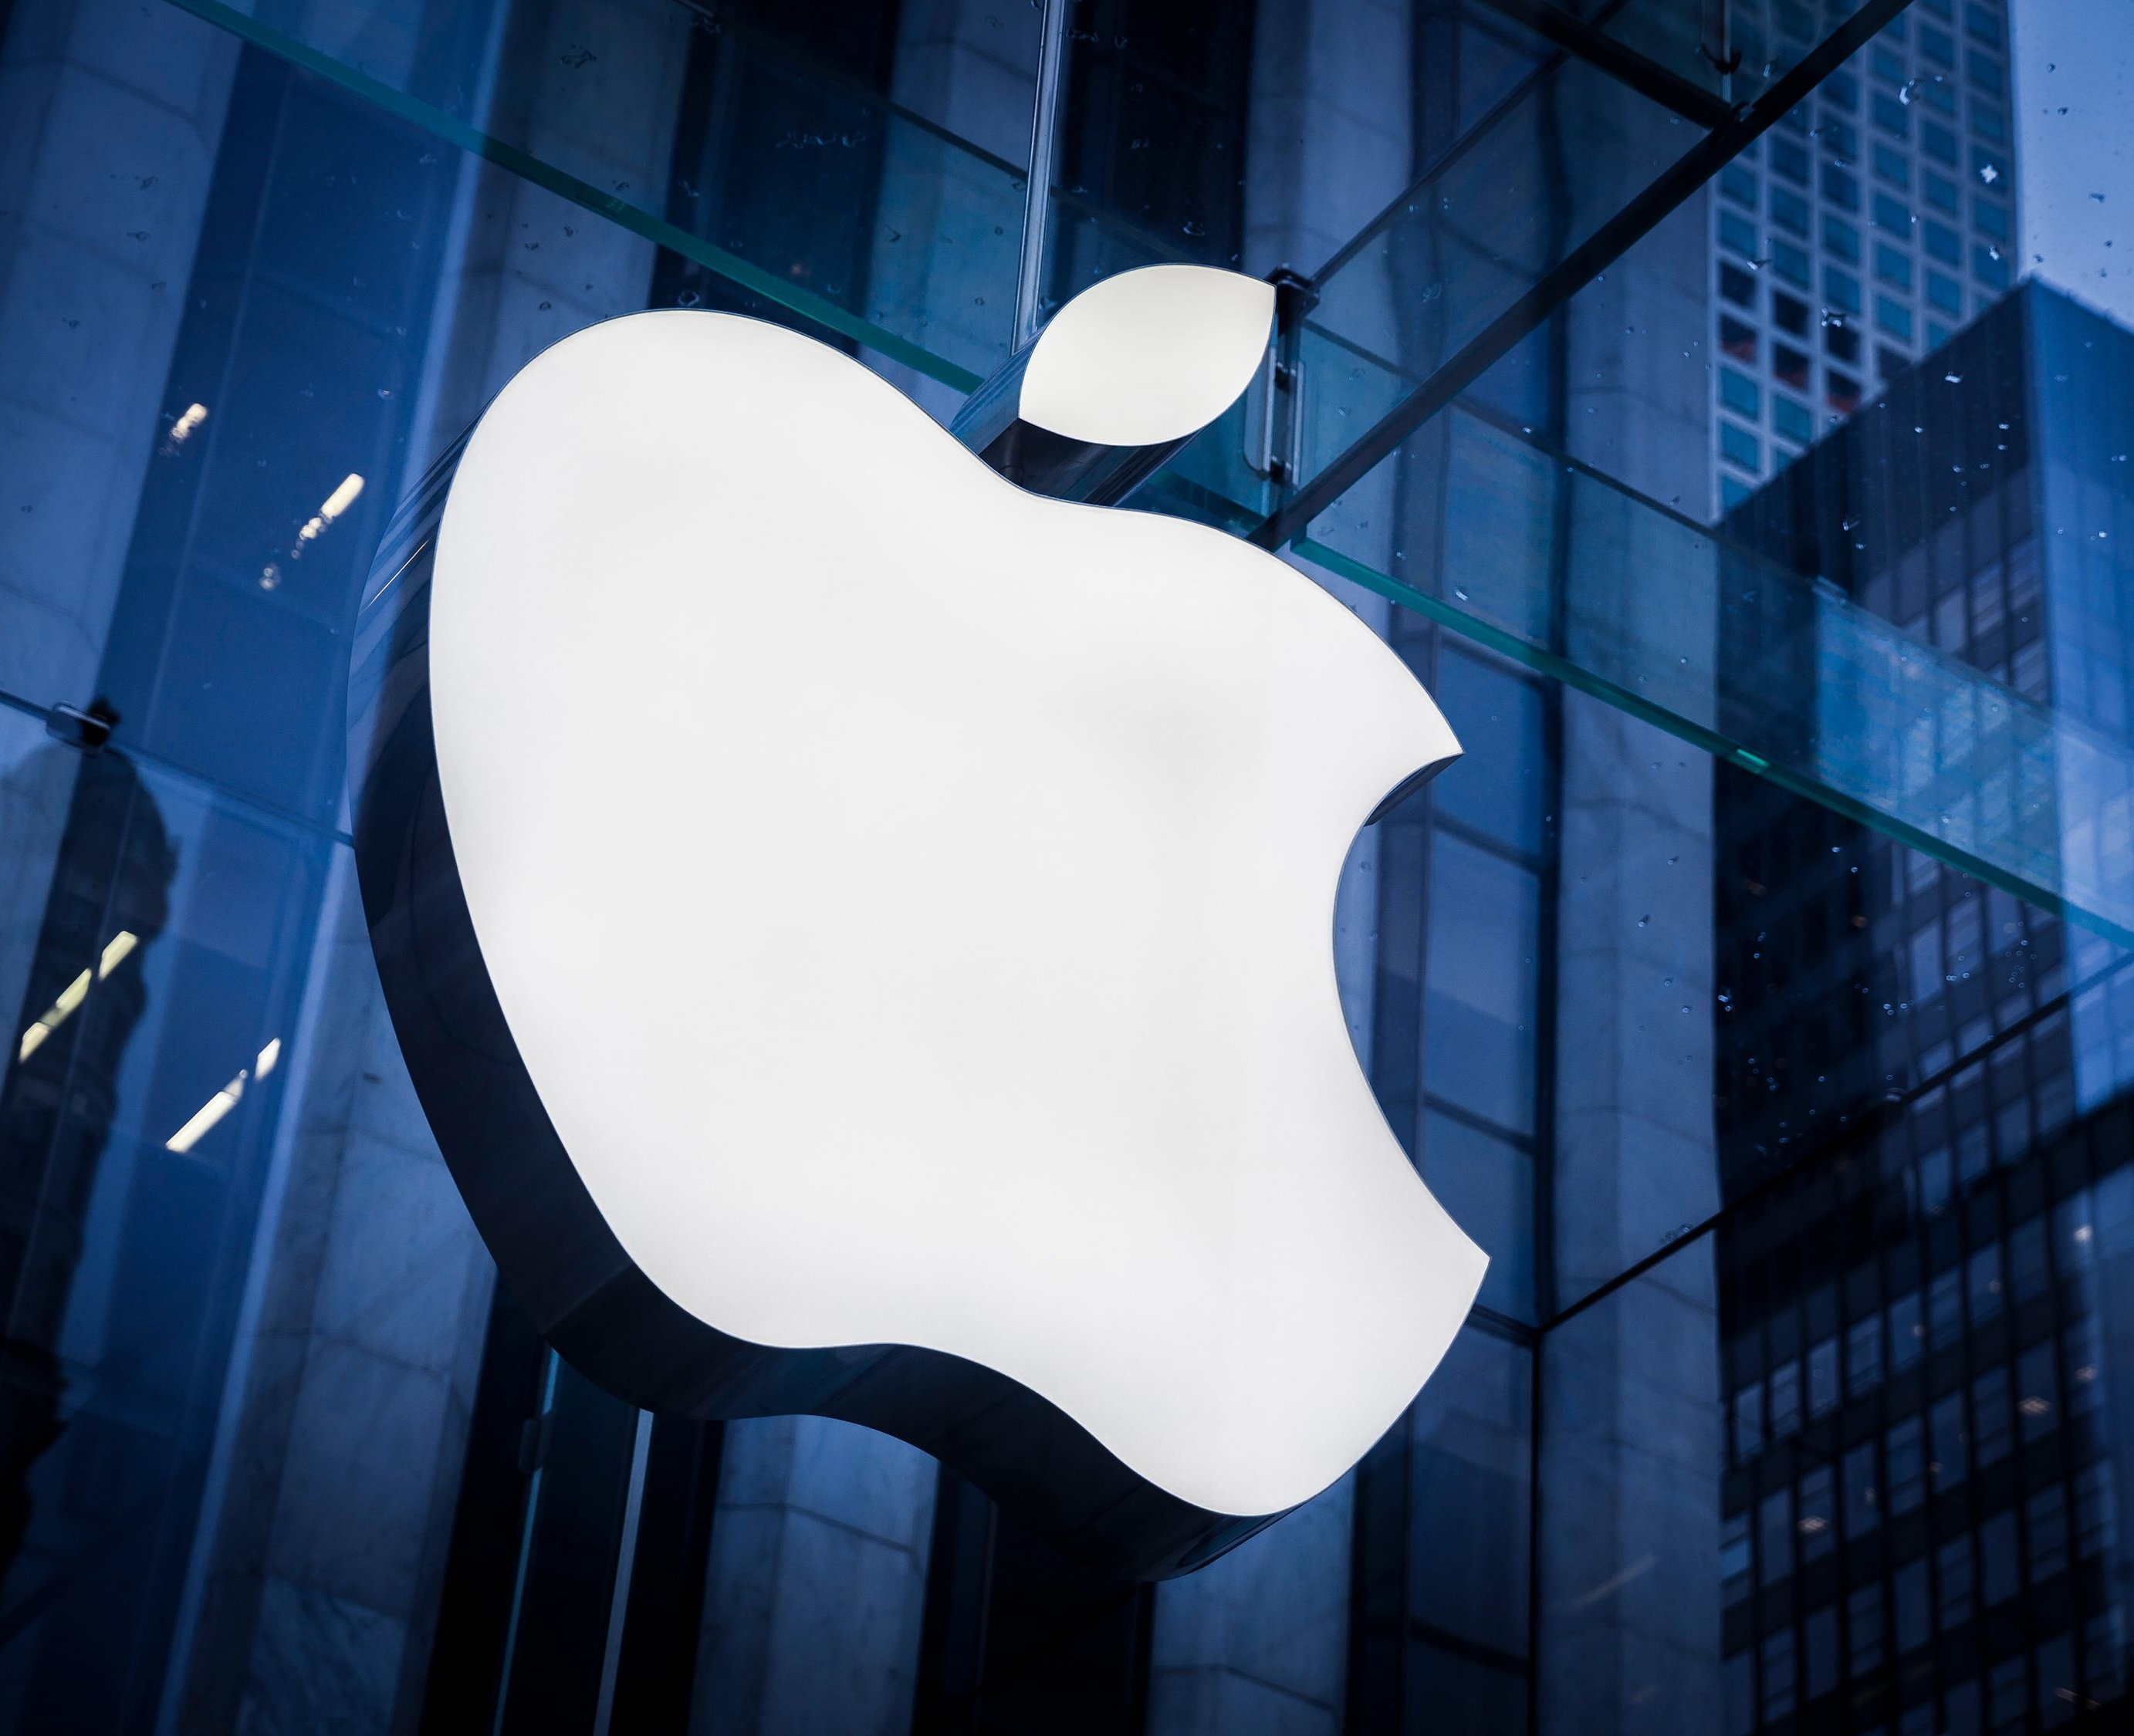
OVERVIEW
Founded: 1976 by Steve Jobs and Steve Wozniak (originally Apple Computer Co.)
Headquarters: Cupertino, California (Silicon Valley).
Products: iPhones, iPads, Macs, Apple Watch, software (iOS, macOS), and services (Apple Music, iCloud).
Pioneered: Graphical user interface (GUI) for personal computers.
Reputation: Innovative design, user-friendly experience, brand loyalty.

Slide 3
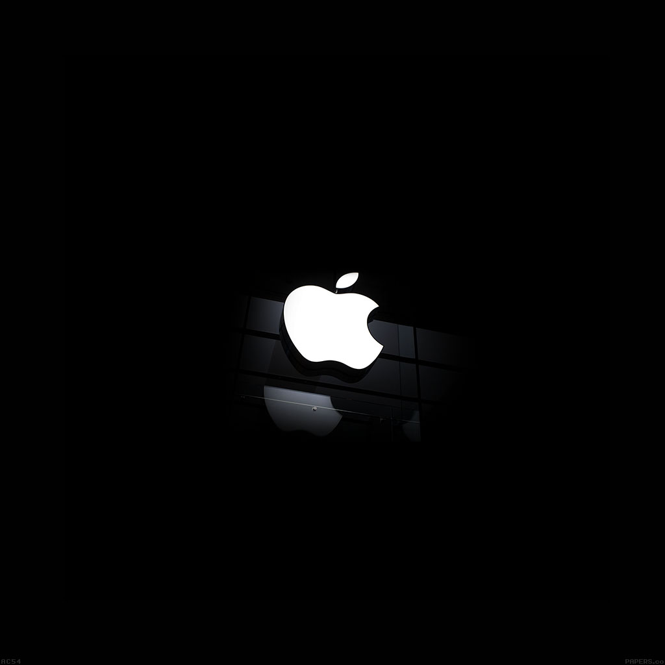
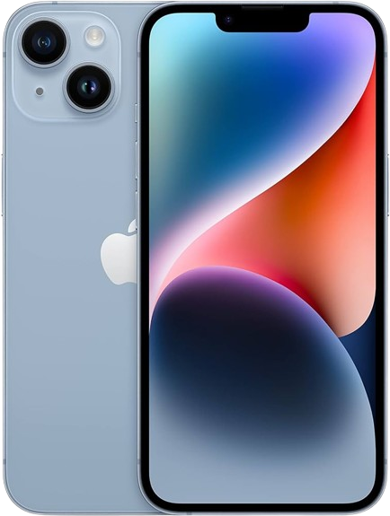
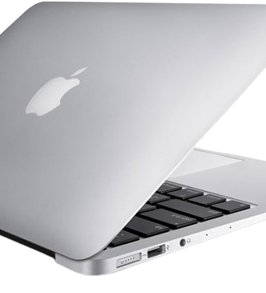
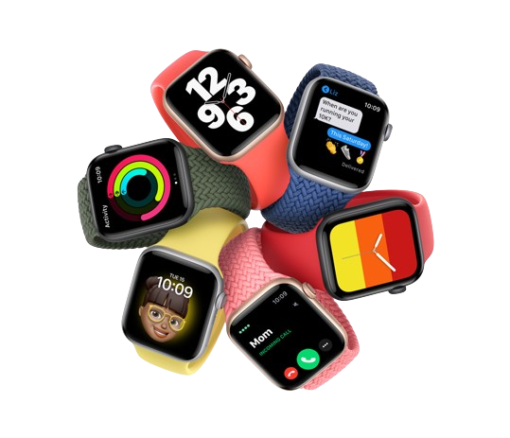
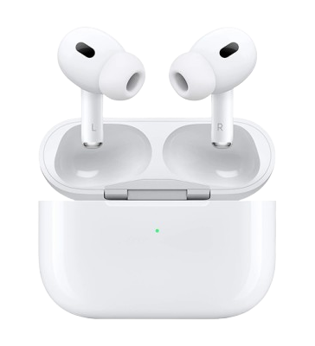
iPhone
Sleek and stylish design.
Powerful A-series chip for fast performance.
Advanced camera system for stunning photos and videos.
Long-lasting battery life.
Large, high-resolution display.
Available in a variety of colors and storage options.
MacBook
Apple watch
AirPods
iPhone

Slide 4
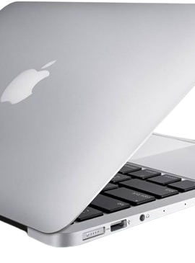
MacBook
Thin and lightweight design for portability.
Powerful M-series chip for demanding task.
Stunning Retina display for vibrant visuals.
Long battery life.
MacOS operating system for a smooth and user-friendly experience.
Available in various screen sizes and configurations.
Apple Watch
AirPods
Iphone
MacBook

Slide 5
Apple watch
Stylish and comfortable design.
Tracks your health and fitness data.
Displays notifications and messages.
Makes and receives calls.
Plays music and podcasts.
Integrates seamlessly with other Apple devices.
AirPods
iPhone
MacBook
Apple Watch

Slide 6
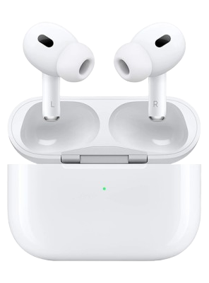
AirPods
Compact and lightweight design for easy portability.
High-quality sound for music, movies, and calls.
Seamless pairing with Apple devices.
Long battery life with charging case.
Active Noise Cancellation (on select models) for an immersive listening experience.
iPhone
MacBook
Apple Watch
AirPods

Slide 7
THE PLATFORM ON WHICH WRBSITE IS DEVELOPED
As per the online verification from www.wappalyzer.com, web framework used by Apple is Next.js
Next.js is a full-stack React framework (Lightweight javascript) that enables the creation of high-quality web applications with built-in optimizations, data fetching, server actions, routing, and more.
• Programming language used by Apple is Node.js

Slide 8
WEBSITE’S RESONSIVE DESIGN & MOBILE OPTIMIZATION
Date of Testing: 10/03/2024
Tested Pages:
https://www.apple.com/
https://www.apple.com/mac/
https://www.apple.com/siri/
https://www.apple.com/shop/buy-watch
https://www.apple.com/contact/
Testing Methodology: We used “BrowserStack Responsive” to evaluate the responsiveness and mobile optimization of the website. The testing involved entering the URL of each page into the tool and analyzing the results.

Slide 9


Best practices for creating visually appealing & user-friendly website designs
Quick Loading Speed
Think Mobile First
Fun Things to Click
Give Space to Breathe
Make Sure It Works Everywhere
Help Everyone Use It

Slide 10
Common website design mistakes to avoid
Cluttered Navigation
Issue: Apple's navigation menu, while sleek, can be overwhelming due to the sheer number of options and submenus.
Suggestion: Simplify the navigation structure by categorizing and prioritizing content. Use concise labels and consider implementing dropdown menus with clear organization.
Lack of Personalization
Issue: The Apple website offers a static experience with limited personalization options. While it presents a unified brand image, it may fail to engage users on a more individual level.
Suggestion: Implement personalized recommendations or dynamic content based on user preferences or browsing history. Tailoring the website experience can enhance user engagement and increase conversion rate.
Heavy Use of Visual Elements
Issue: The Apple website features numerous high-resolution images and videos, which can contribute to slow loading times, especially on slower internet connections or older devices.
Suggestion: Optimize images and videos for web use without compromising quality. Utilize lazy loading techniques to prioritize content above the fold and defer the loading of nonessential media.
Limited Text Accessibility
Issue: While Apple's design emphasizes visuals, some essential information may be conveyed primarily through images or videos, potentially excluding users with visual impairments or those using screen readers.
Suggestion: Ensure all important information is accessible via text. Provide descriptive alt text for images and transcripts for videos to improve accessibility for all users.

Slide 11


RECOMMENDATION
Address minor text alignment issues on the shop/buy-watch Page to ensure consistency across all devices.
Optimize the positioning of elements on the shop/buy-watch Page for better alignment on smaller screens.
Improve accessibility by providing forms on the Contact Us Page to enhance user experience.

Slide 12

CONCLUSION
Strong foundation: The website exhibits good responsiveness and mobile optimization, indicating a solid base for user experience across devices.
Room for improvement: Opportunities exist to further refine the user experience.
Enhanced performance: Implementing recommended changes will improve the website's overall performance and usability.

Slide 13

LANDING PAGE
https://mailchi.mp/4d0e7219060a/iphones

Slide 14
REFERENCE
https://www.apple.com/:
• The page displayed well on various screen sizes, with content adjusting
appropriately.
• Navigation elements were easily accessible on mobile devices.
• No significant issues were identified.
•https://www.apple.com/mac/:
• Text and images remained readable across different screen sizes.
• No significant issues were identified.
•https://www.apple.com/siri/:
• The page maintained good responsiveness, with content scaling effectively.
• No significant issues were identified.
•https://www.apple.com/shop/buy-watch
• The page maintained good responsiveness, with content scaling effectively.
• However, the positioning of certain elements seemed slightly off on smaller screens.
• Fonts not aligned properly
•https://www.apple.com/contact/:
• The Contact Us page exhibited satisfactory responsiveness overall.
• No significant issues were identified.

Slide 15

THANK YOU!
Surbhi Verma
Batch-DM24 GUVI

